Slide 1
The Fashion Game

Slide 2
Coordination Game
Adam
H
T
1,1 | -1,-1
-1,-1 | 1,1
H
Boris
T

Slide 3
Coordination Game
Adam
H
T
1,1 | -1,-1
-1,-1 | 1,1
H
Boris
Pure Nash Equilibrium (PNE)
T

Slide 4
Matching-Pennies
Adam
H
T
-1,1 | 1,-1
1,-1 | -1,1
H
Boris
T

Slide 5
Matching-Pennies
Adam
H
T
-1,1 | 1,-1
1,-1 | -1,1
H
Boris
No PNE!
T

Slide 6
Matching-Pennies
Adam
H
T
-1,1 | 1,-1
1,-1 | -1,1
H
Boris
T
Rebel
Conformist

Slide 7
Rebel
Conformist

Slide 8
Rebel
Conformist
0
1
0
1
S = {0,1}
0

Slide 9
Rebel
Conformist
0
1
+1
0
1
-1
+1
+1
S = {0,1}
0
$$π\left(\text{Rebel}\right)=2$$

Slide 10
Rebel
Conformist
0
1
0
1
S = {0,1}
0

Slide 11
$∀$p $\left|N_{R}(p)\right|≤\left|N_{C}(p)\right|$ => PNE exists
0
1
$\left|N_{C}(p)\right|$ - $\left|N_{R}(p)\right|$ $≥$ 0
$\left|N_{C}(p)\right|$ - $\left|N_{R}(p)\right|$ $≥$ 0
$$1. π\left(p,0\right)=−π(p,1)$$
$$π\left(p\right)≥0 ↔p is stable$$

Slide 12
Bipartite graph,
rebels and conformists separated,
one agent has odd degree => no PNE exists
$$1. π\left(p,0\right)=−π(p,1)$$
$$2. \sum_{∀p}{π(p)}=0$$

Slide 13
Bipartite graph,
rebels and conformists separated,
one agent has odd degree => no PNE exists
1
0
$$1. π\left(p,0\right)=−π(p,1)$$
0
$$2. \sum_{∀p}{π(p)}=0$$
1

Slide 14
Paper starts here

Slide 15
Weighted
Rebel
Conformist
0
1
+1
5
0
1
-1
2
+1
1
+1
2
S = {0,1}
0
$$π\left(\text{Rebel}\right)=6$$

Slide 16
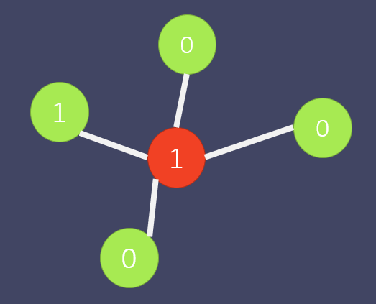
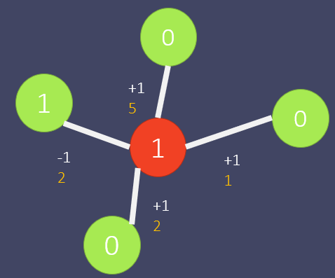
FG $≥_{p}$ WFG

Slide 17
2

Slide 18
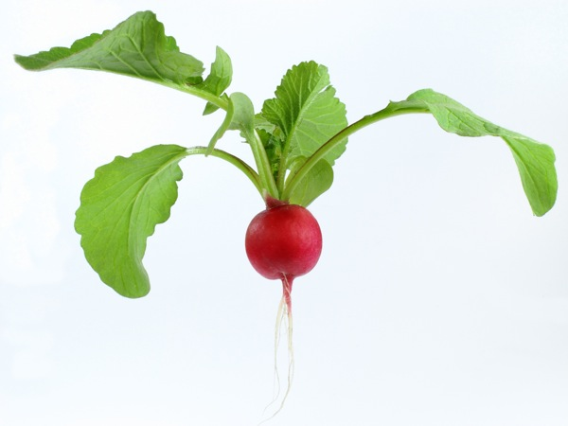

Slide 19
1
1
1
1
1
0
0
0
Same
0

Slide 20
2
1
0
=
1
1
1
0
0
0

Slide 21
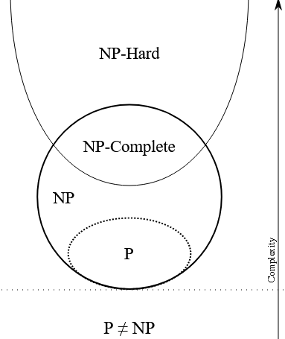
How to show NP-Completness for WFG?
1. It has to belong to NP.
2. It has to be NP-Hard.

Slide 22
How to show NP-Completness for WFG?
1. It has to belong to NP.
Correct answer verifiable in O(n^2)
2. It has to be NP-Hard.

Slide 23
How to show NP-Completness for WFG?
1. It has to belong to NP.
Correct answer verifiable in O(n^2)
2. It has to be NP-Hard.
Reduction to «Exact-3SAT» problem WFG $≥_{p}$ Exact-3SAT

Slide 24
3SAT
Exact-
Literal
$$F=(\overline{x_{1}}∨x_{2}∨x_{3})∧(x_{2}∨\overline{x_{3}}∨x_{4})∧(x_{1}∨\overline{x_{2}})$$
Clause
$$F=(\overline{x_{1}}∨x_{2}∨x_{3})∧(x_{2}∨\overline{x_{3}}∨x_{4})∧(x_{1}∨\overline{x_{2}}∨x_{4})$$

Slide 25
$$F=(\overline{x_{1}}∨x_{2}∨x_{3})∧(x_{2}∨\overline{x_{3}}∨x_{4})∧(x_{1}∨\overline{x_{2}}∨x_{4})$$
$x_{1}$ $\overline{x_{1}}$
$x_{2}$ $\overline{x_{2}}$
$x_{3}$ $\overline{x_{3}}$
$x_{4}$ $\overline{x_{4}}$

Slide 26
$$F=(\overline{x_{1}}∨x_{2}∨x_{3})∧(x_{2}∨\overline{x_{3}}∨x_{4})∧(x_{1}∨\overline{x_{2}}∨x_{4})$$
$x_{1}$ $\overline{x_{1}}$
$x_{2}$ $\overline{x_{2}}$
$x_{3}$ $\overline{x_{3}}$
$x_{4}$ $\overline{x_{4}}$

Slide 27
3
$$F=(\overline{x_{1}}∨x_{2}∨x_{3})∧(x_{2}∨\overline{x_{3}}∨x_{4})∧(x_{1}∨\overline{x_{2}}∨x_{4})$$
4
4
4
4
$x_{1}$ $\overline{x_{1}}$
$x_{2}$ $\overline{x_{2}}$
$x_{3}$ $\overline{x_{3}}$
$x_{4}$ $\overline{x_{4}}$

Slide 28
3
$$F=(\overline{x_{1}}∨x_{2}∨x_{3})∧(x_{2}∨\overline{x_{3}}∨x_{4})∧(x_{1}∨\overline{x_{2}}∨x_{4})$$
0
4
4
4
4
$x_{1}$ $\overline{x_{1}}$
$x_{2}$ $\overline{x_{2}}$
$x_{3}$ $\overline{x_{3}}$
$x_{4}$ $\overline{x_{4}}$

Slide 29
0
3
$$F=(\overline{x_{1}}∨x_{2}∨x_{3})∧(x_{2}∨\overline{x_{3}}∨x_{4})∧(x_{1}∨\overline{x_{2}}∨x_{4})$$
0
4
4
4
4
$x_{1}$ $\overline{x_{1}}$
$x_{2}$ $\overline{x_{2}}$
$x_{3}$ $\overline{x_{3}}$
$x_{4}$ $\overline{x_{4}}$

Slide 30
0
3
$$F=(\overline{x_{1}}∨x_{2}∨x_{3})∧(x_{2}∨\overline{x_{3}}∨x_{4})∧(x_{1}∨\overline{x_{2}}∨x_{4})$$
0
1
1
1
4
4
4
4
$x_{1}$ $\overline{x_{1}}$
$x_{2}$ $\overline{x_{2}}$
$x_{3}$ $\overline{x_{3}}$
$x_{4}$ $\overline{x_{4}}$

Slide 31
0
3
$$F=(\overline{x_{1}}∨x_{2}∨x_{3})∧(x_{2}∨\overline{x_{3}}∨x_{4})∧(x_{1}∨\overline{x_{2}}∨x_{4})$$
0
1
1
1
0
1
1
0
0
1
1
0
4
4
4
4
$x_{1}$ $\overline{x_{1}}$
$x_{2}$ $\overline{x_{2}}$
$x_{3}$ $\overline{x_{3}}$
$x_{4}$ $\overline{x_{4}}$

Slide 32
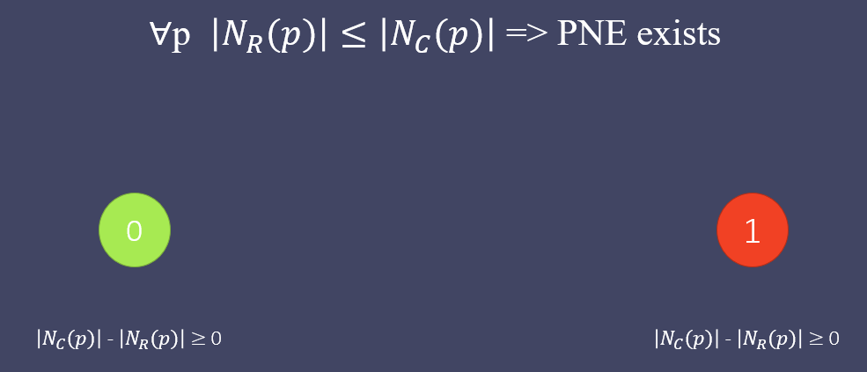
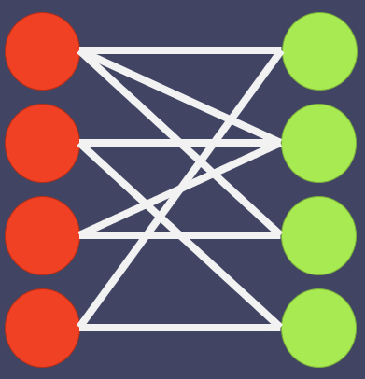
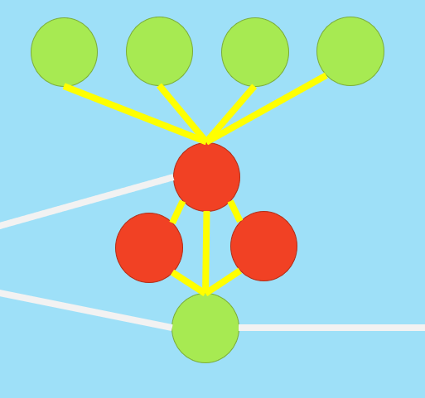
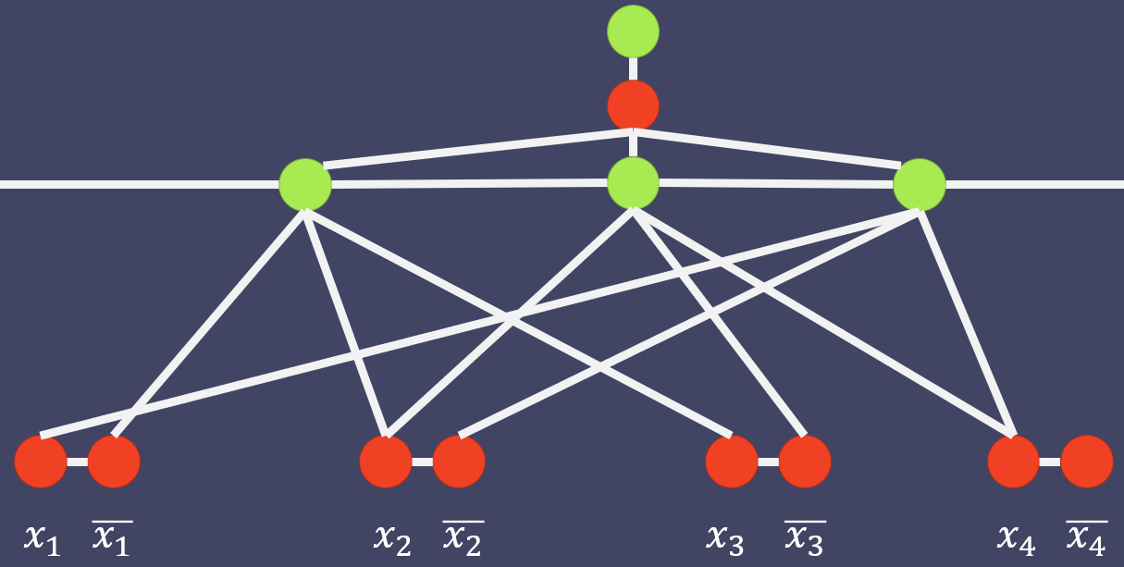
Recap
NP-Hard
$$≥_{p}$$
$$≥_{p}$$
$$F=\left(\overline{x_{1}}∨x_{2}∨x_{3}\right)∧$$
$\left(x_{2}∨\overline{x_{3}}∨x_{4}\right)∧$
$(x_{1}∨\overline{x_{2}}∨x_{4})$
NP-Complete

